Slide 1

ABV-IIITM Gwalior
DBMS Project
B.Tech – 2nd Semester Academic Year 2020-2021
Project -
MOVIE RECOMMENDATION SYSTEM
Database Systems by
— Dr. Debanjan Sadhya
Submitted By -
Student Roll no. | Student Name
2020BCS-013 | Anurag Yadav
2020BCS-014 | Arun Kumar Rathod
2020BCS-015 | Aryan Dadhich
2020BCS-016 | Ashish Singh
2020BCS-017 | Ashwin Kumar Singh
2020BCS-018 | Bachute Sarvesh Vikas

Slide 2
Table of Contents
Project Description
Entities and Attributes
ER Diagram
Schema Diagram and Normalisation
Relational and SQL Queries
Slide no - 4
Slide no - 5
Slide no - 6-7
Slide no - 8 to 20
Slide no - 21 to 37

Slide 3

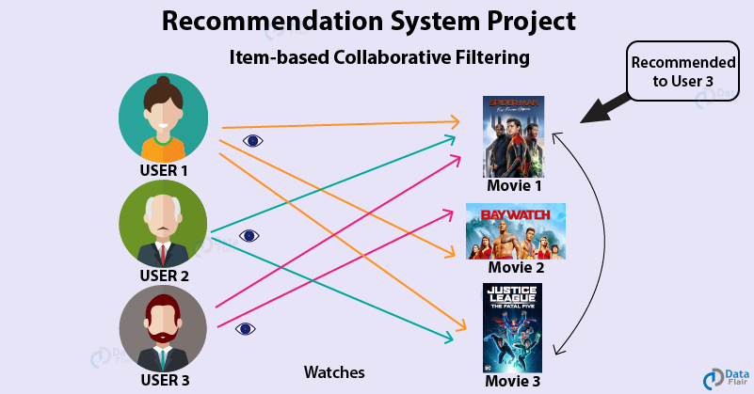


Slide 4
Project Description
This project is about creating the database about Movie Recommendation System.
The movie recommendation system facilitates the audience to view and research about the movies available on the basis of genre type, language, release year, also they can search according to their favorite actors or directors etc. The aim this project is to design and develop a database maintaining the records of different movies, specifications etc.. The record of movies includes its release year, name, platform, language, actor directors, genre , ratings , gross market.
Viewers can look for movies with different kind of customised searches. For recomendation, viewers has to provide the desired industry or genre etc in the form of queries. Before displaying a movies for a viewer, the availability of movie checked. Similarly, all the search commands are executed and movies are filtered out.. If such combination exist, the list of movies is shown for the viewer to choose..
Some of assumption and exceptions are also taken since the movie database is very large in reality, it is not feasible to develop the case study to that extent and prepare documentation at that level. Therefore, a small sample database has been created to demonstrate the working of the Movie Recommendation System.

Slide 5
Entities and Attributes
\
Attributes
Entities
Movies
Actors
Directors
Platform
Genre
Ratings
Gross Market
movie_id
movie_name
release_year
industry
duration
actor_id
actor_name
director_id
director_name
platform_id
Movies
Actors
Directors
Platform
Genre
Ratings
Gross Market
platform_name
genre_id
genre_name
critics_review
no_of_stars
average_rating
total_votes
total_collection
movie_budget
profit

Slide 6
ER Diagram

Slide 7
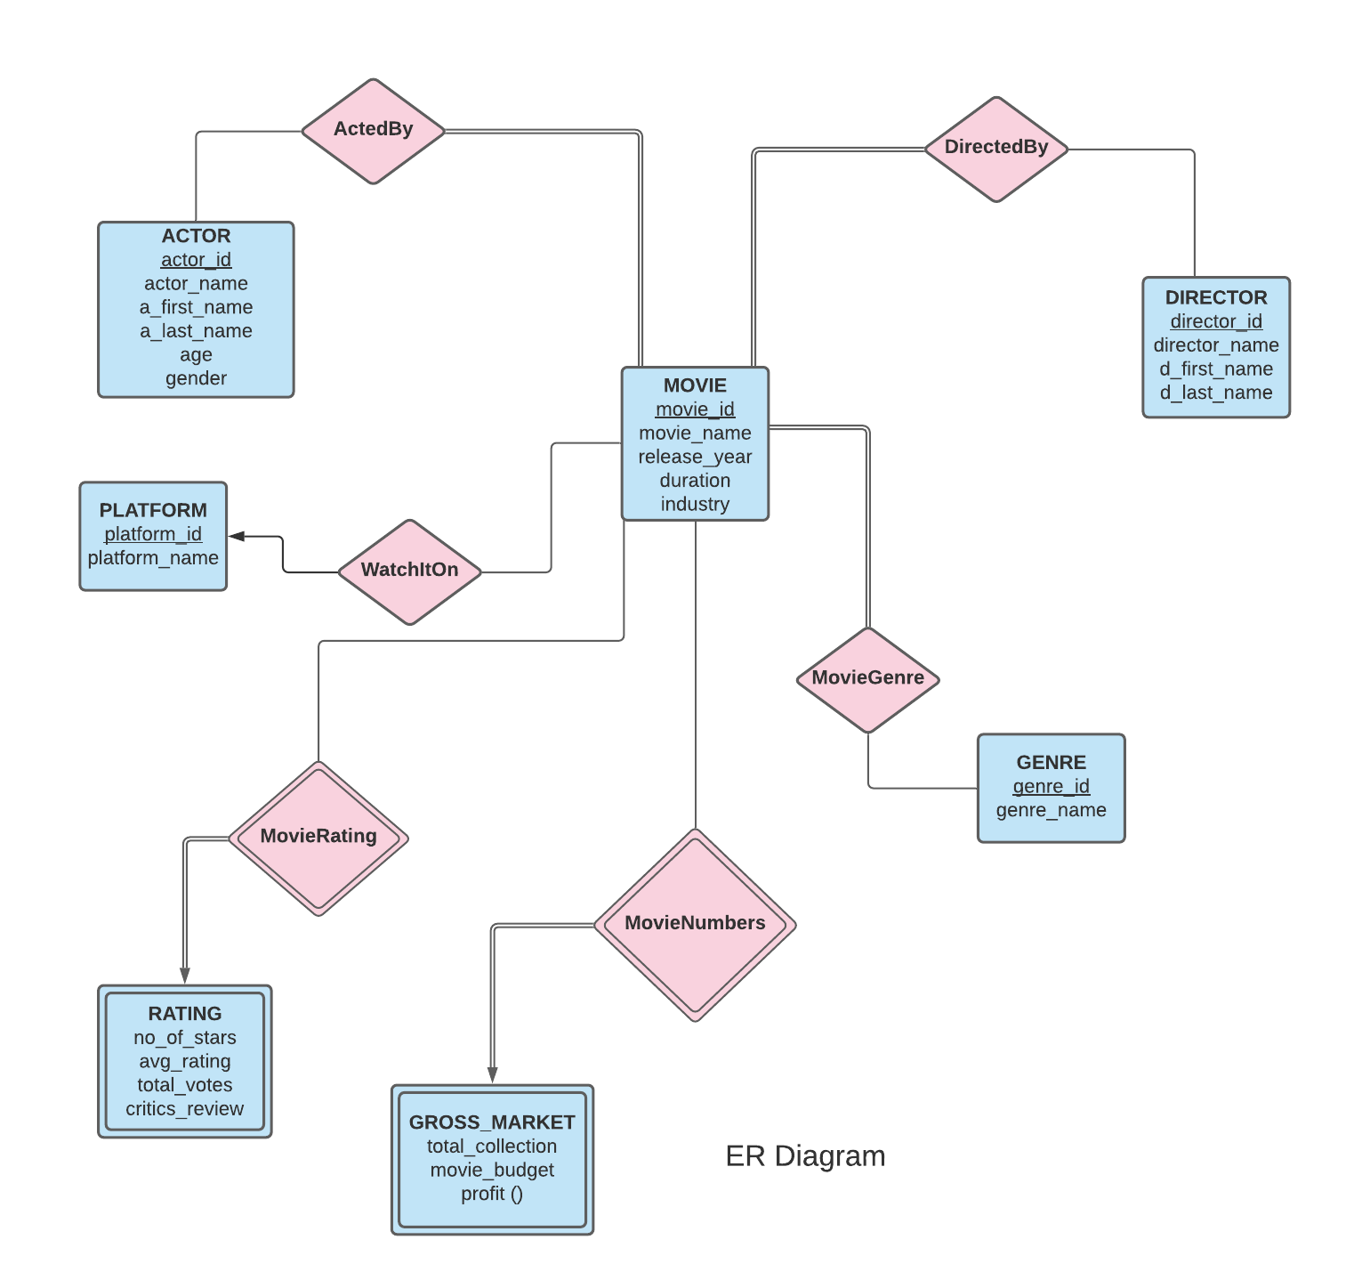

Slide 8
Schema Diagram
MOVIES
movie_id | movie_name | release_year | industry | duration
NOTE- as movie names are unique so other things can easily be found by movie name but as primary key is a candidate key which is minimum super key(if one attribute can be identify uniquely so we have to choose either one of them) so we can either choose movie_id or movie_name as primary key and since it is our choice which key to choose, so we have chose the movie_id
Primary key
Functional dependencies
Movie_id --> movie_name, release year, industry, duration.
Movie name --> release year, industry, duration, Movie_id
NORMALISED TO BCNF
MOVIES_ONE
movie_id | movie_name
MOVIES_TWO
movie_name | release_ year | industry | duration

Slide 9
Schema Diagram
ACTORS
actor_id | a_first_name | a_last_name | age | gender
Functional dependencies
Actor_id → (a_first_name, a_last_name, age, gender)
Primary key
NORMALISED TO BCNF
ACTORS
actor_id | a_first_name | a_last_name | age | gender

Slide 10
Schema Diagram
DIRECTORS
director_id | d_first_name | d_last_name
Functional dependencies
Director_id → (d_first_name, d_last_name)
Primary key
NORMALISED TO BCNF
DIRECTORS
director_id | d_first_name | d_last_name

Slide 11
Schema Diagram
PLATFORM
platform_id | platform_name
Functional dependencies
Platform_id→ (platform_name)
Primary key
NORMALISED TO BCNF
PLATFORM
platform_id | platform_name

Slide 12
Schema Diagram
Genre
genre_id | genre_name
Functional dependencies
Genre_id → (genre_name)
Primary key
NORMALISED TO BCNF
Genre
genre_id | genre_name

Slide 13
Schema Diagram
RATINGS
movie_id | critics_review | no_of_stars | avg_rating | total_votes
Primary key
Functional dependencies
Movie_id → (critics_review, no_of_stars, avg_ratings, total_votes)
NORMALISED TO BCNF
RATINGS
movie_id | critics_review | no_of_stars | avg_rating | total_votes

Slide 14
Schema Diagram
GROSS_MARKET
movie_id | total_collection | movie_budget | profit
Functional dependencies
Primary key
Movie_id→ (total_collection, movie_budget, profit)
Total_collection, movie_budget - ( profit)
NORMALISED TO BCNF
GROSS_MARKET_ONE
movie_id | total_collection | movie_budget
GROSS_MARKET_TWO
total_collection | movie_budget | profit

Slide 15
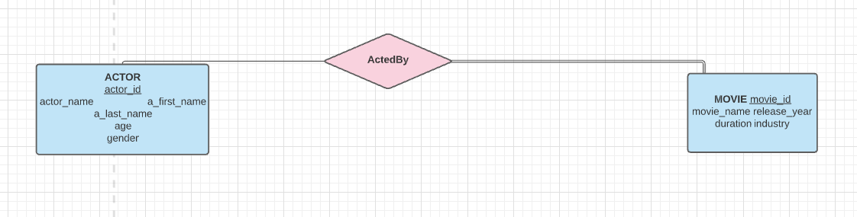
Schema Diagram
ACTED_BY
movie_id | actor_id
Relation description
denoting relation between movies and actor
is a many to many relation as movies can have many actors associated also actors can take part in different movies
there is total participation of movie as each movie should have actors associated with it.
Primary key

Slide 16
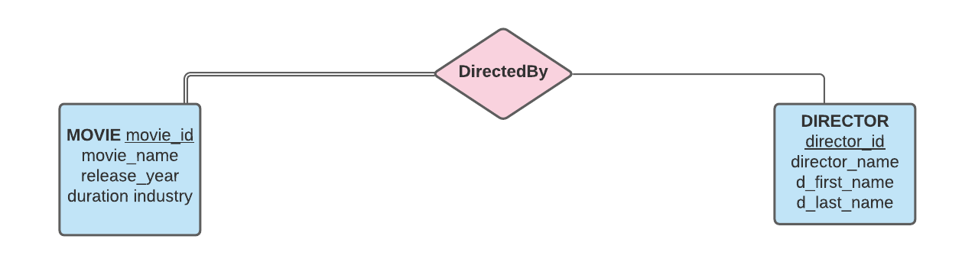
Schema Diagram
DIRECTED_BY
movie_id | director_id
Relation description
denoting relation between movies and director
iis assumed to be many to manyrelationship as we consider that each movie can have only one director, also
there is total participation of movie as each movie should have director associated with it.
Primary key

Slide 17
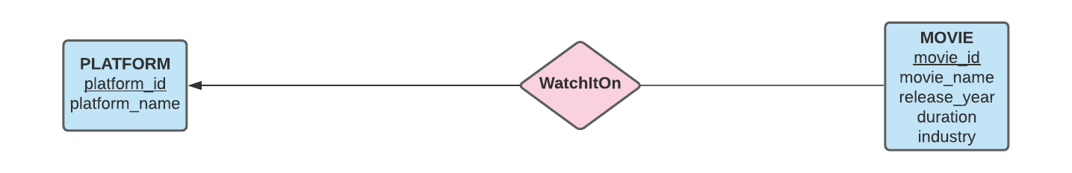
Schema Diagram
WATCH_IT_ON
platform_id | movie_id
Relation description
denoting relation between movies and platform
iis assumed to be many to one relationship as we consider that each movie is available on only one platform and a platform can have multiple movies
Primary key

Slide 18
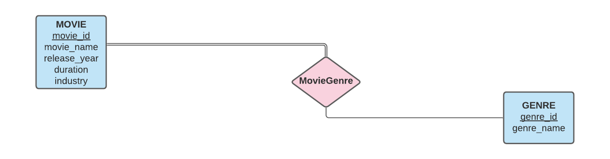
Schema Diagram
MOVIE_GENRE
genre_id | movie_id
Functional dependencies
Relation description
denoting relation between movies and genre
is assumed to be many to many relationship as movies can have more than one genre also genres are associated with more than one movie, also
there is total participation of movies as each movie should have atleast one genre
Primary key

Slide 19
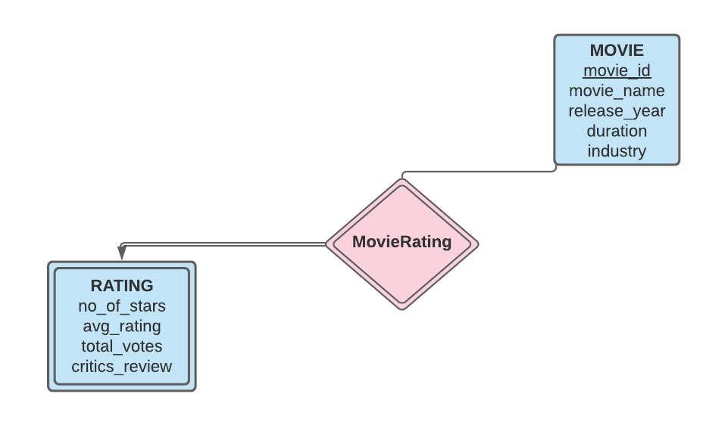
Schema Diagram
MOVIE_RATING
movie_id | critics_review | no_of_stars | avg_rating | total_votes
This relation is redundant as it is identifying relation and the schema for ratings already contains all the information.
Primary key
Relation description
is an identifying relationship between movies and ratings as ratings do not have primary key so is a weak entity.
schema of identifying relationships have primary key of the strong entity and discriminators of weak entities.

Slide 20
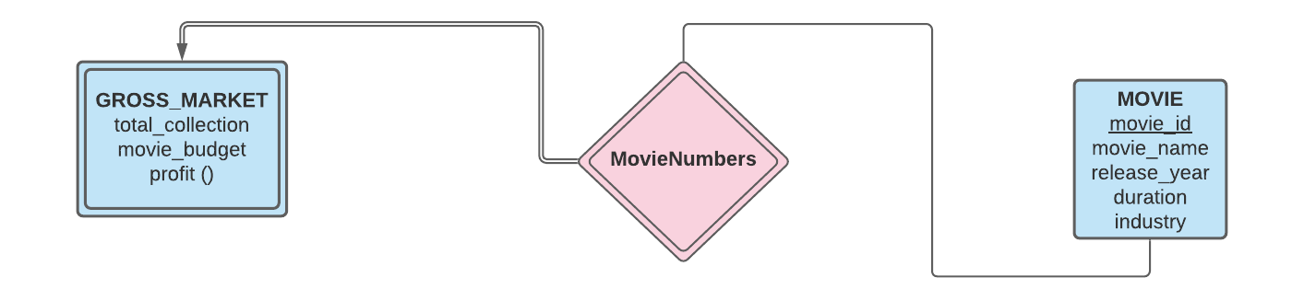
Schema Diagram
MOVIE NUMBERS
movie_id | total_collection | movie_budget | profit
Primary key
Relation description
Functional dependencies
is an identifying relationship between movies and gross market as gross market do not have primary key so is a weak entity.
profit is a derived attribute of budget and collection
This relation is redundant as it is identifying relation and the schema for gross market already contains all the information.

Slide 21
Relational and SQL Queries
Reference to Database --- https://docs.google.com/spreadsheets/d/1y6pNvims0cLEaLDi0VGMFPzczzdPLx_QJtuCmyfm-oY/edit#gid=0

Slide 22
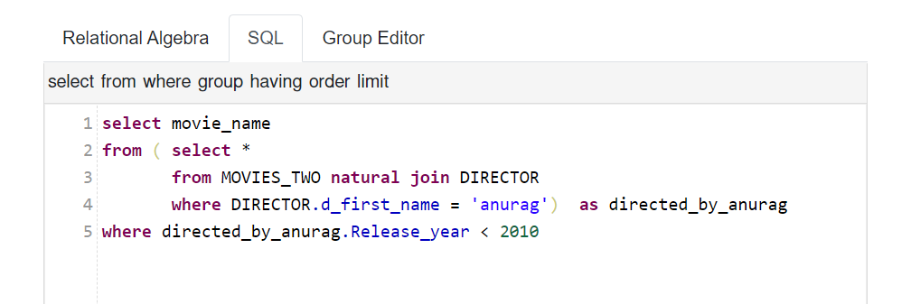
Q. Finding the movies directed by anurag before 2010

Slide 23
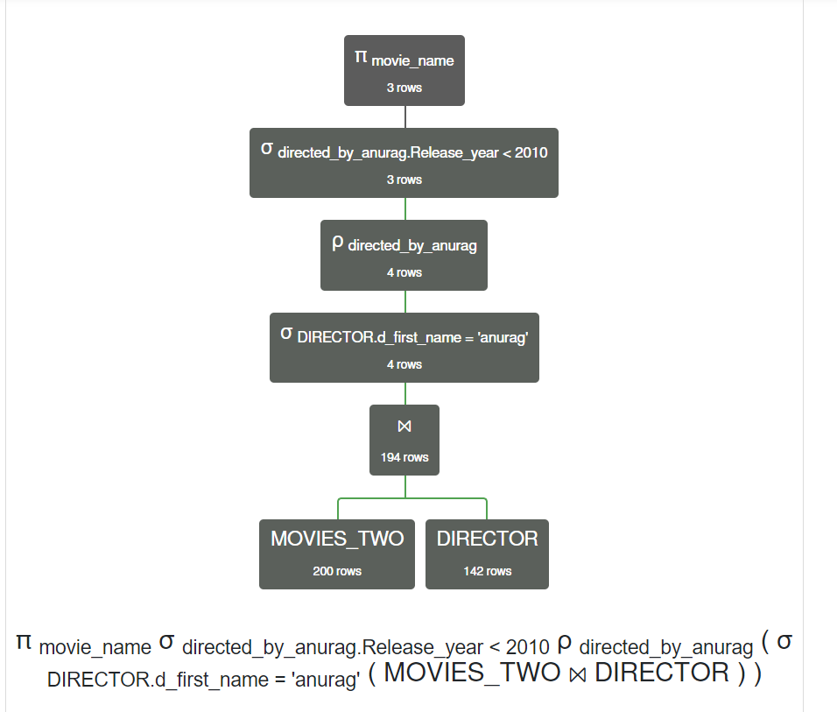
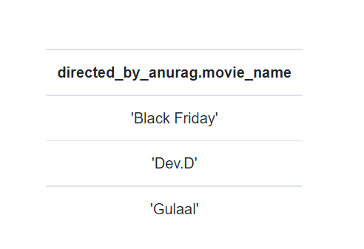

Slide 24
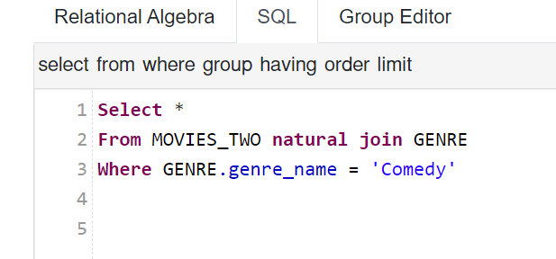
Q. Finding the names of the movies with comedy genre

Slide 25
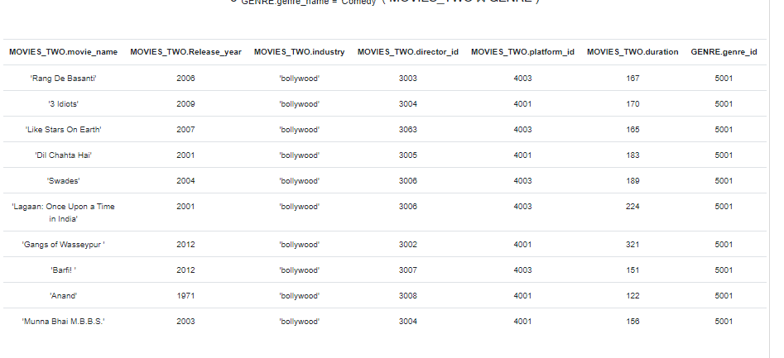

Slide 26
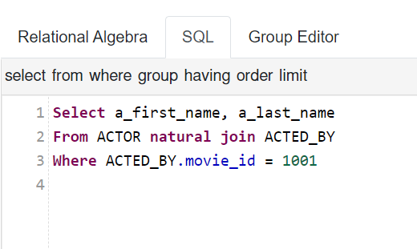
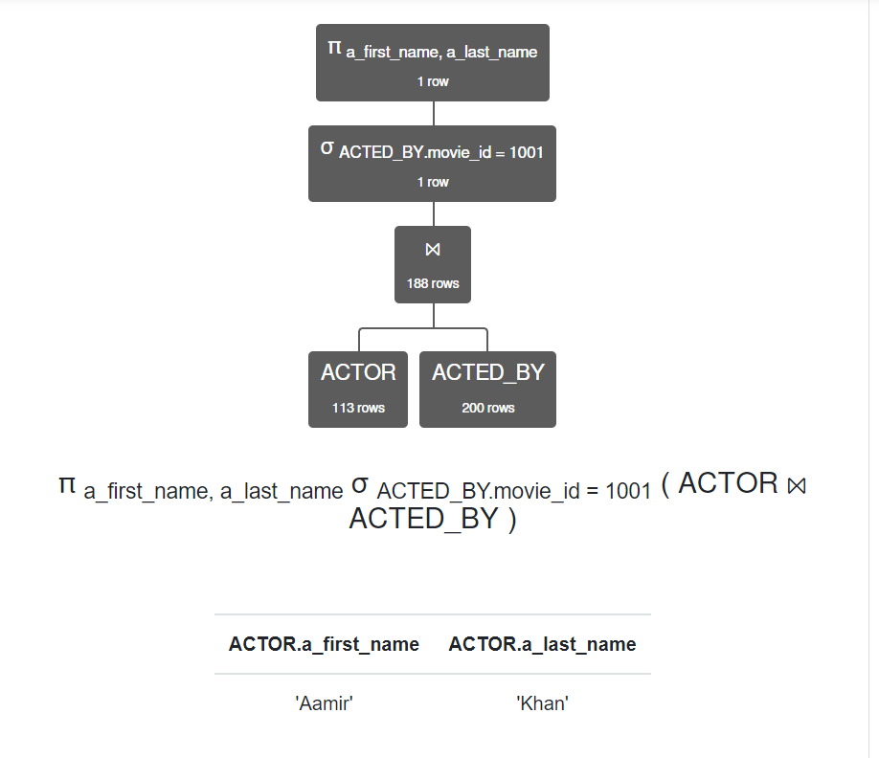
Q. Finding the names of the actors who were a part of a particular movie

Slide 27
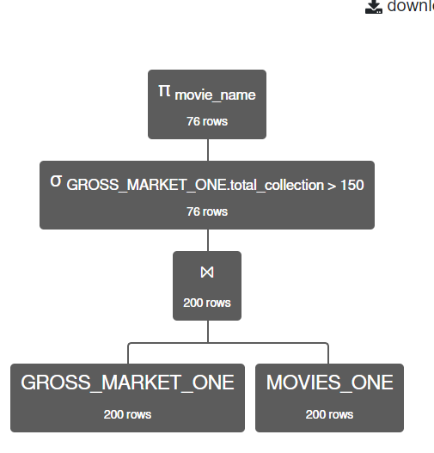
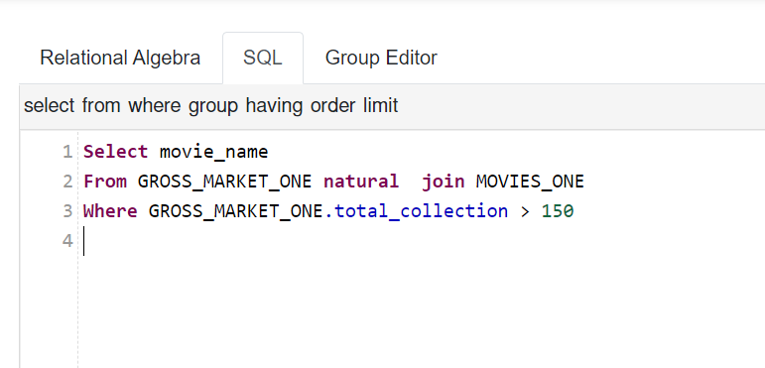
Q. Finding the movies with a total collection greater than 150cr

Slide 28
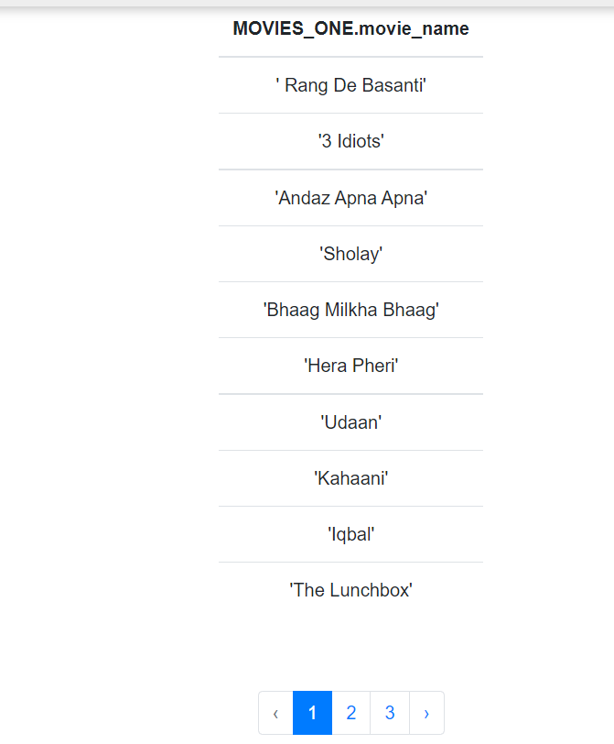
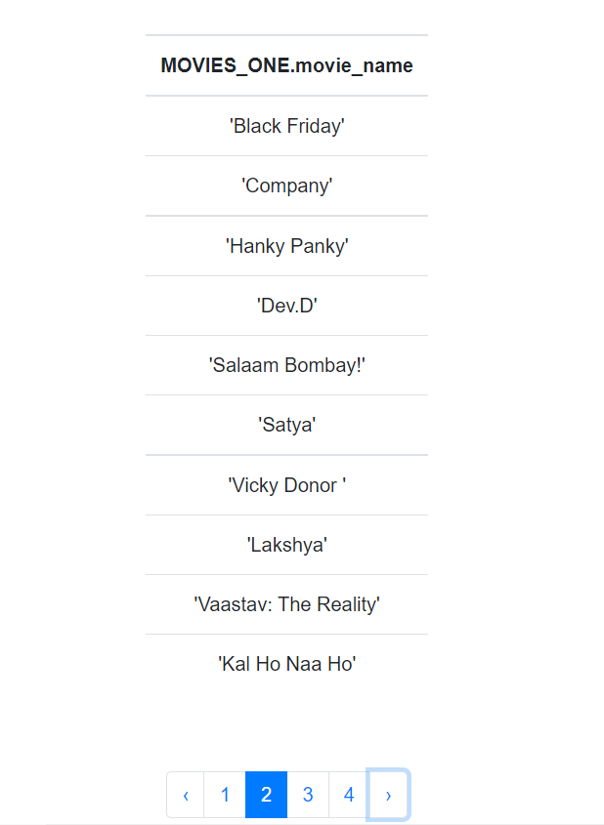
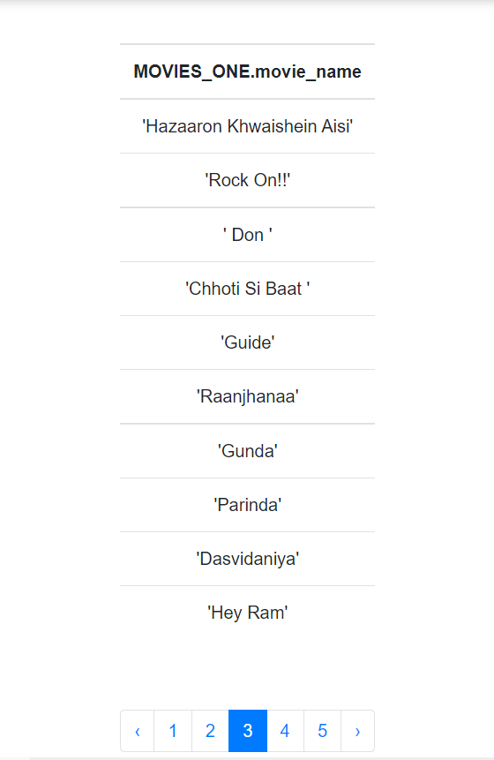

Slide 29
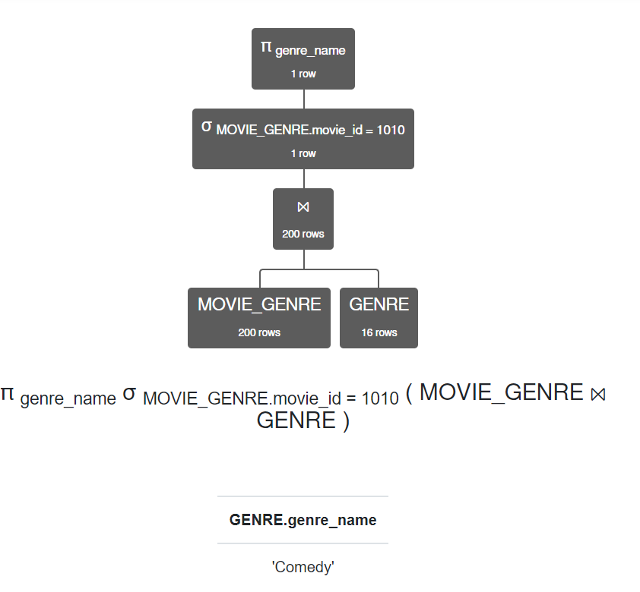
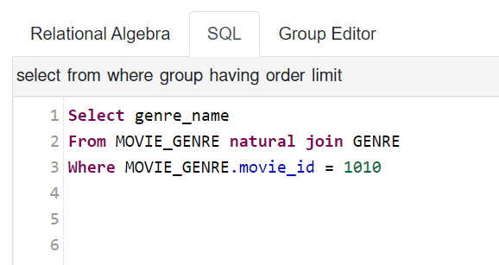
Q. Finding the genres of the movie

Slide 30
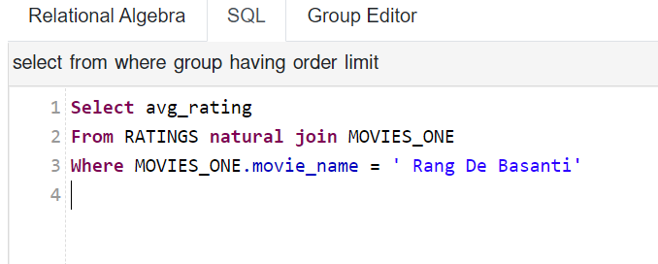
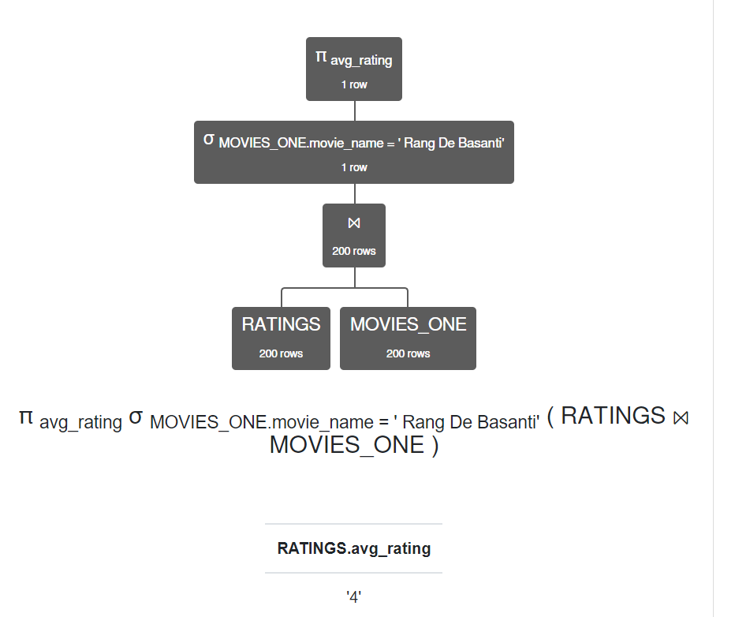
Q. Finding the average ratings of a movie

Slide 31
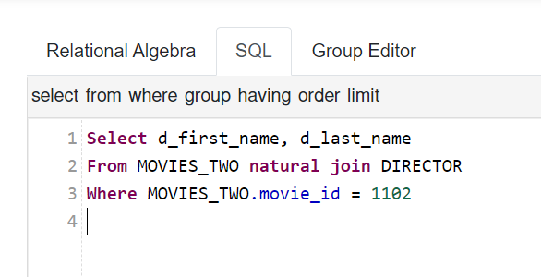
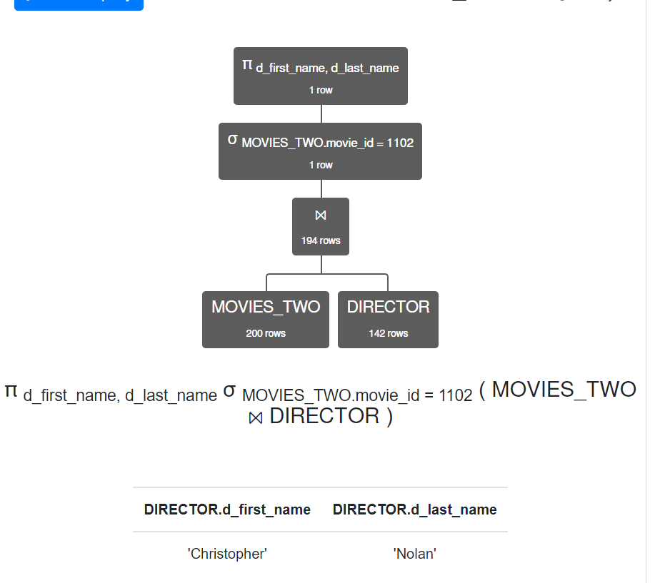
Q. Finding the names of the directors of a particular movie

Slide 32
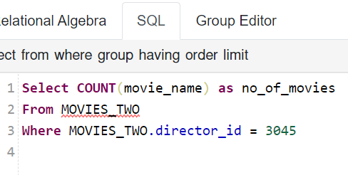
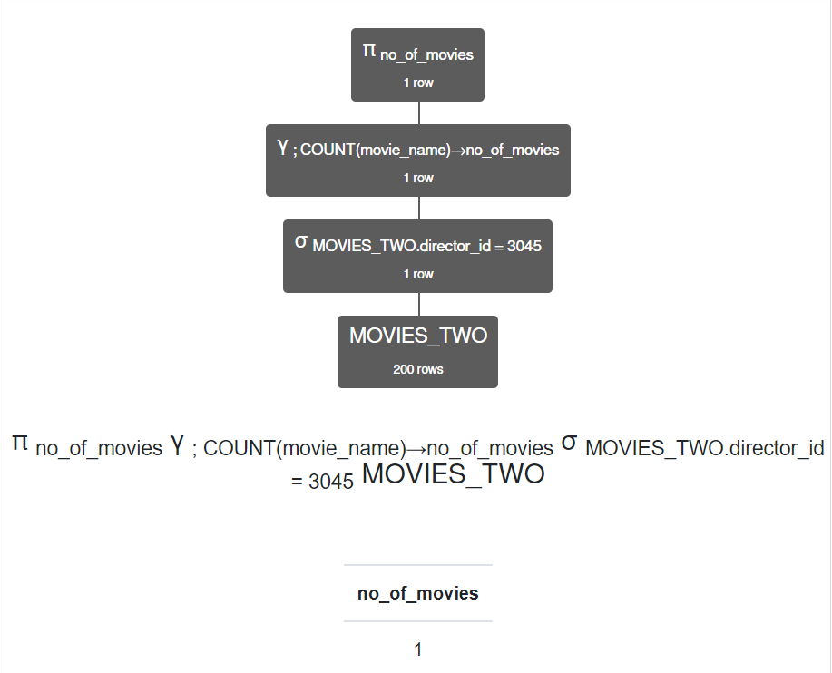
Q. Finding the number of movies that are in the database directed by a particular director

Slide 33
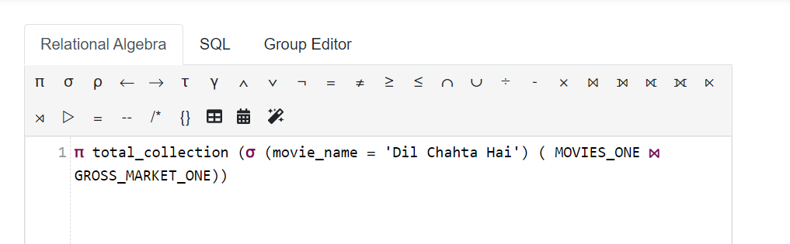
Q. Finding the total collection of the movie “dil chahta hai”

Slide 34
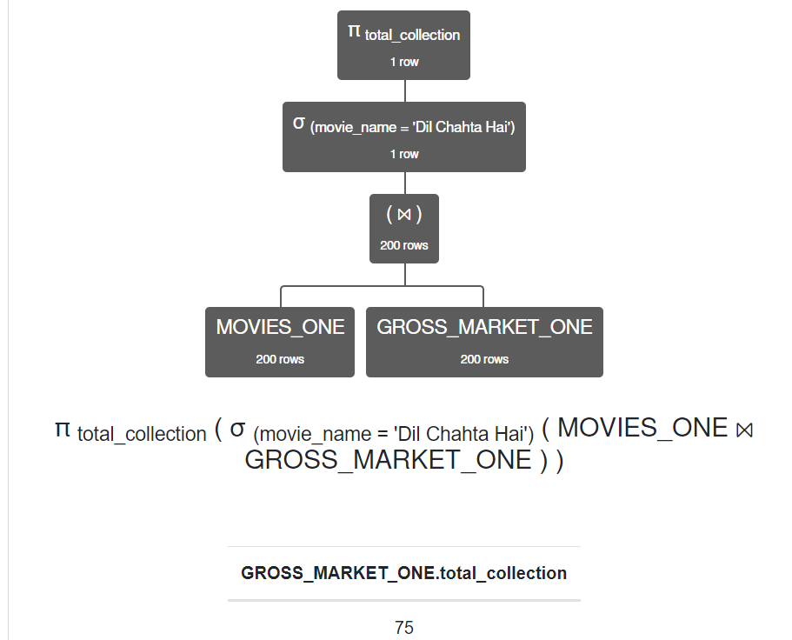

Slide 35
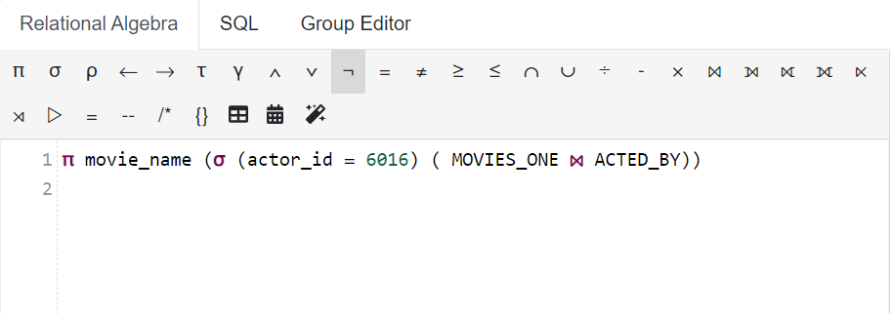
Q. Finding the names of the movies in which a particular actor worked on

Slide 36
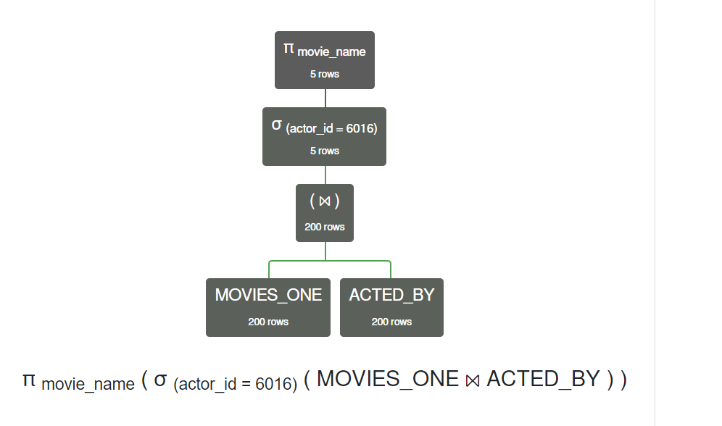
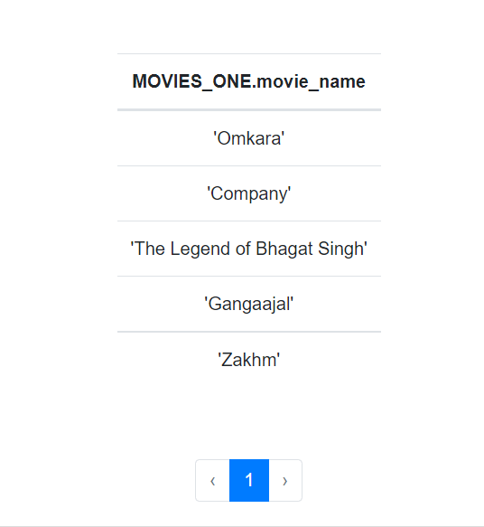

Slide 37
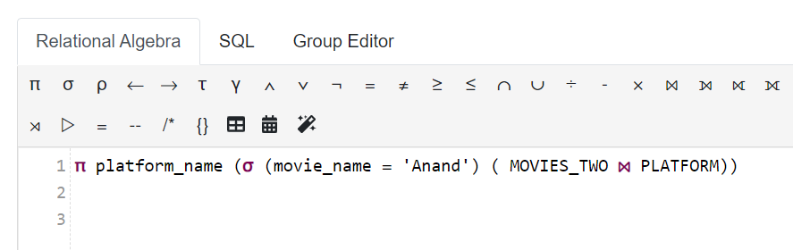
Q. Finding the platform name on which a particular movie is available

Slide 38
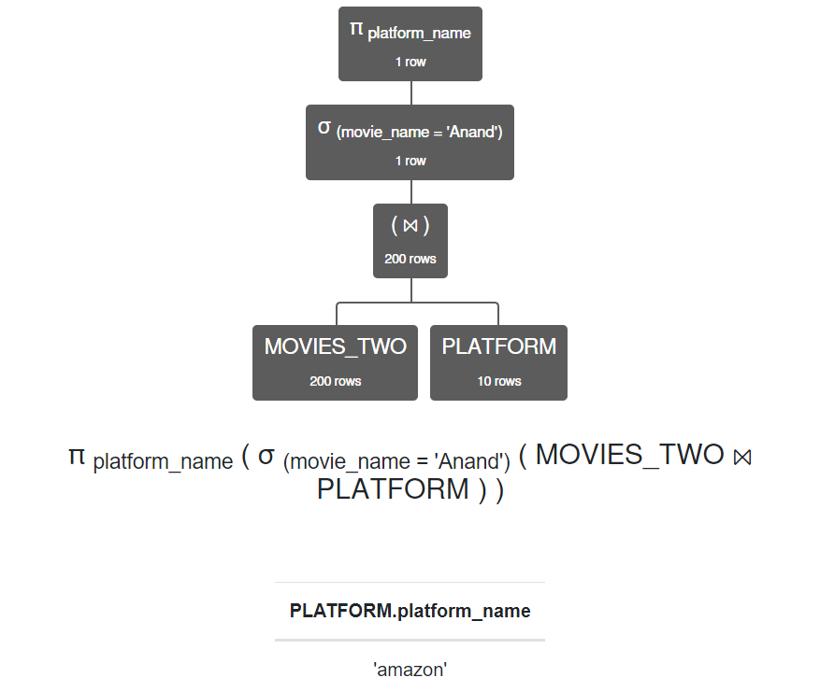

Slide 39
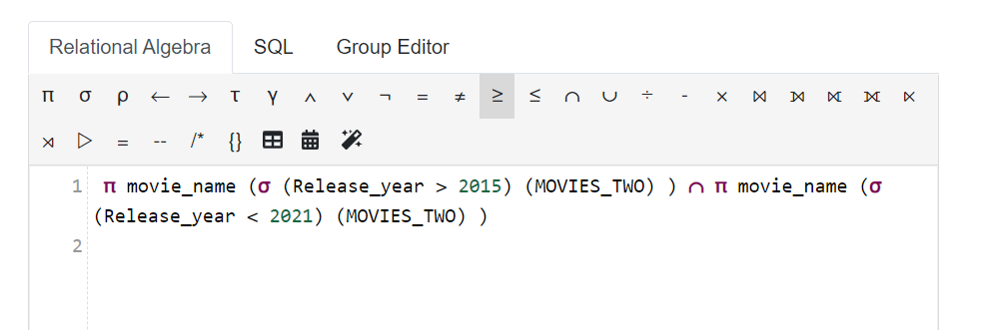
Q. Finding the movie name of the movies that were released after 2015 and before 2021

Slide 40
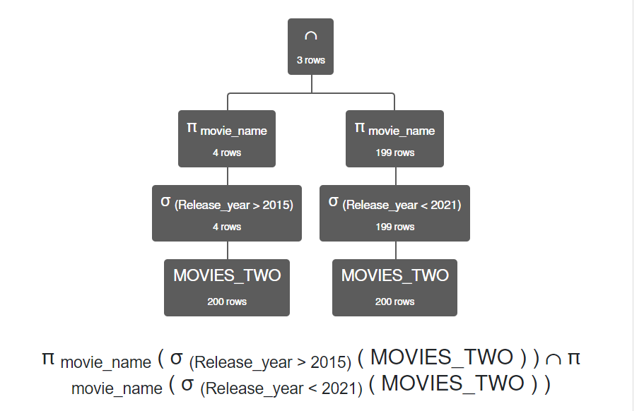
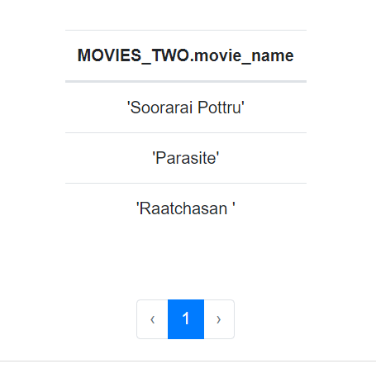

Slide 41
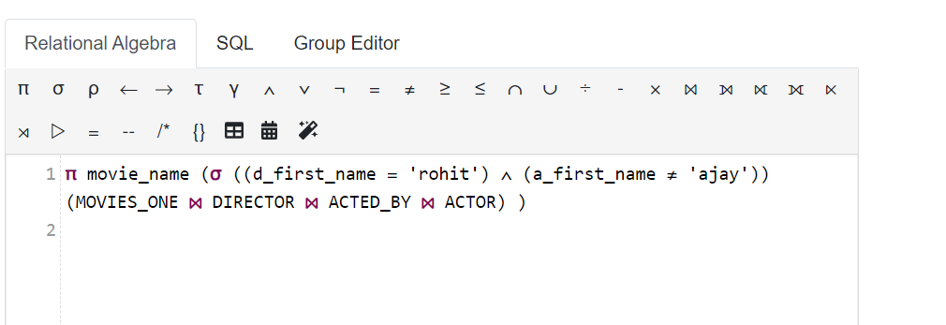
Q. Finding the names of the movies for which the director’s first name was ‘rohit’ but the actor with first name ‘ajay’ was not a part of the movie.

Slide 42
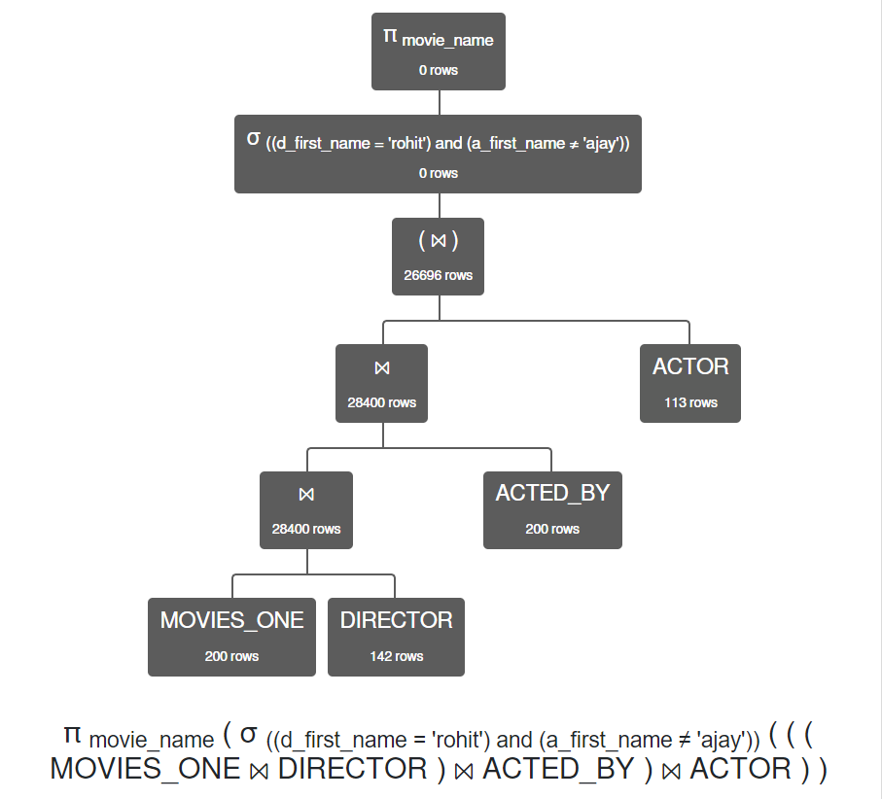
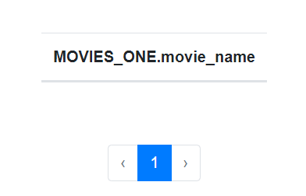

Slide 43
Thank You

